Slide 1
Exploring Toronto, Finding the Best Neighborhoods to Live In as well as to Open an Asian Restaurant
IBM Data Science Professional Certificate - Capstone Project

Slide 2
Introduction
Moving to a new city is often a big challenge because of many reasons.
Keeping in mind all these problems, I created a hypothetical scenario in which a client wants to move from ‘Clifton, Karachi’ to ‘Toronto, Canada’ and he wants me to help him with following problems:
1. Help him explore the city.
2. Find him the most suitable neighborhood to live in. He wants to live in a neighborhood as similar as possible to his old neighborhood in Karachi, Pakistan.
3. Find him the optimal neighborhood to open his high-end Asian restaurant.

Slide 3
Importance
This project is helpful for several people, for instance:
1. Anyone who is planning to move to Toronto. This is an example for people moving from Karachi to Toronto, but the similar analysis can be done for any other pair of cities.
2. Anyone who wants to explore any city.
3. Anyone who wants to open a business in a city. We did analysis for a high-end Asian restaurant in Toronto, but similar analysis can be done for any other kind of restaurant as well as for any other kind of business in any city

Slide 4
Project Goal
As our problem has three parts, so, let us tackle each part separately. I proposed following solutions, respectively, for each part:
1. Build a data set comprising of venues located in each neighborhood of 'Toronto, Canada' and then cluster neighborhoods based on common venue types present there
2. Include client's present neighborhood (along with venues located there) in the data set and perform clustering and filtering .
3. Cluster neighborhoods on basis of total population, Asian population, average household income and number of high earning household in each neighborhood.

Slide 5
Data Sources
1. Client provided his present address.
2. Neighborhoods of Toronto, along with their postal codes would be scraped from Wikipedia.
3. A geocoding library Geopandas will be used to get geocoordinates of each neighborhood.
4. These geocoordinates would then be used to extract top 100 venues in each neighborhood within 500m radius (as 500m is a reasonable walking distance) using Foursquare API.
5. Toronto’s demographic data is obtained from Toronto's Open Data Portal.

Slide 6
Problem 1
I gathered Toronto’s neighborhoods’ data using Wikipedia, Geopandas, and Foursquare to build a data set that contains top 100 venues located in each neighborhood within 500m radius.
You can see the top 30 most common venues in Toronto in the next slide.

Slide 7
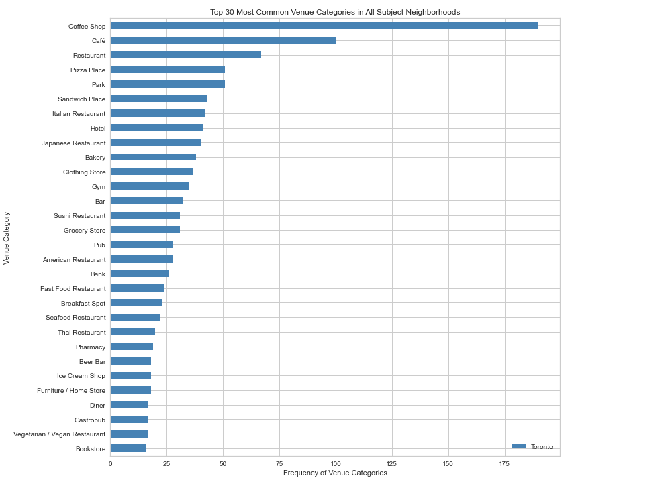

Slide 8
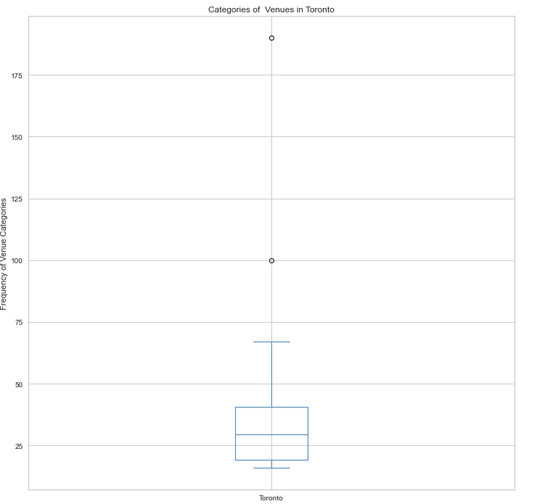
Also, you can see that frequency of occurrence of the most venues are around 35-40 but there are some exceptional cases too:

Slide 9
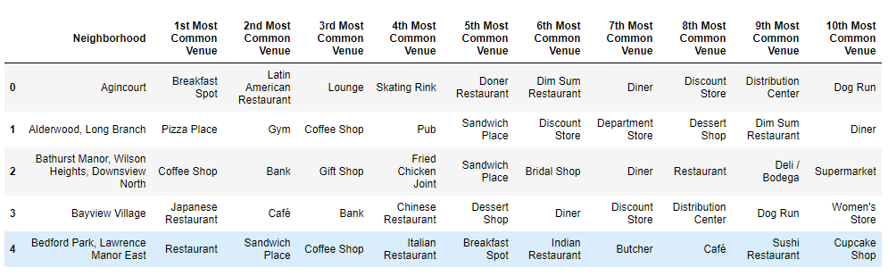
I extracted venue category of each venue and then extracted the top 10 most common venue categories in each neighborhood as shown below:

Slide 10
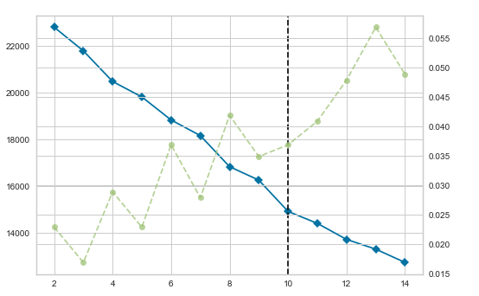
Clustering
I clustered neighborhoods based on common type of venues located in each neighborhood using an unsupervised machine learning algorithm, K-Means (it is basically a clustering algorithm).
In K-Means, we must choose k i.e. the number of clusters we want our dataset to be divide into. I chose elbow method to find the best k (k = 10) as you can see below:

Slide 11
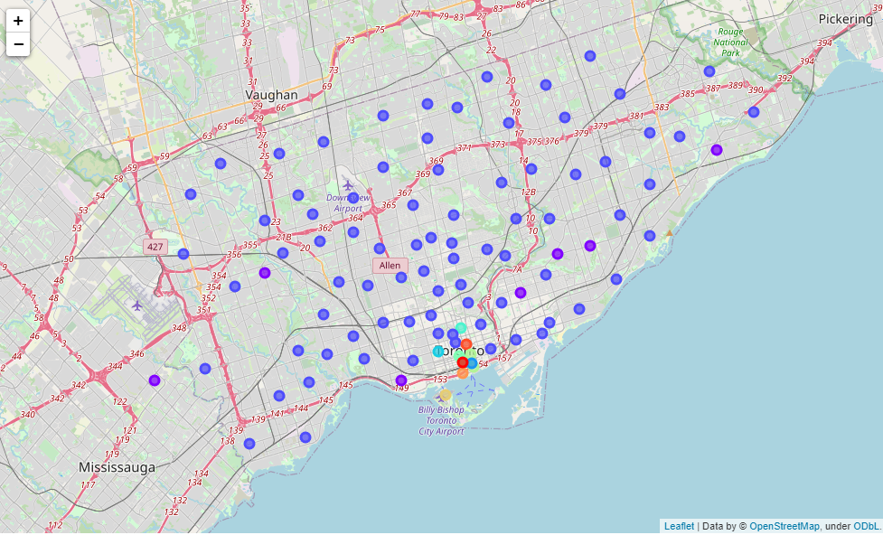
We can see here that the best k is 10, i.e. we will find the best result if we divide our dataset into 10 clusters. So, I did the same and did show the clustered neighborhoods on map using color coding, as you can see below:

Slide 12
Conclusion
We can see that a big majority of neighborhoods fall under one cluster (cluster 1).
This cluster's most common venue categories are the ones fulfilling basic human needs. So, you can find almost anything, you need on daily basis, in these neighborhoods.
Other neighborhoods include, along with basic needs providing venues, some sort of special venues like bars or hotels etc. So, client can always refer to these clusters whenever he wants to visit a specific type of venue or wants to know the category of his target neighborhood.

Slide 13
Problem 2
This chapter tackles problem 2 i.e. finding client the best neighborhood to live in.
Data Collection and Exploratory Analysis:
We used the dataset built for problem 1 along with client’s present address to tackle this problem.
Clustering and Filtering:
As discussed in the section ‘How we will use this data?’ I performed repeated clustering and filtering on this data set until number of neighborhoods in the filtered data set fell below 20.

Slide 14
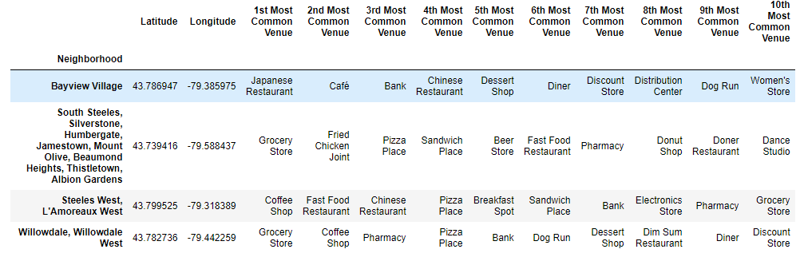
Conclusion
We found client the optimal neighborhoods to live in, as shown below:

Slide 15
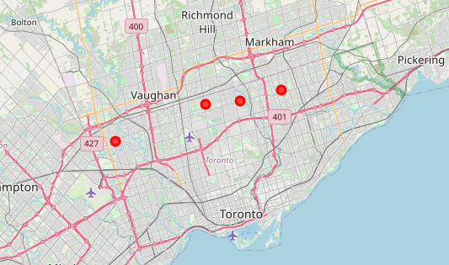
Same neighborhoods on Toronto’s map are also shown below:

Slide 16
Problem 3
This chapter tackles problem 3 i.e. finding client the optimal location to open his high-end Asian restaurant.

Slide 17
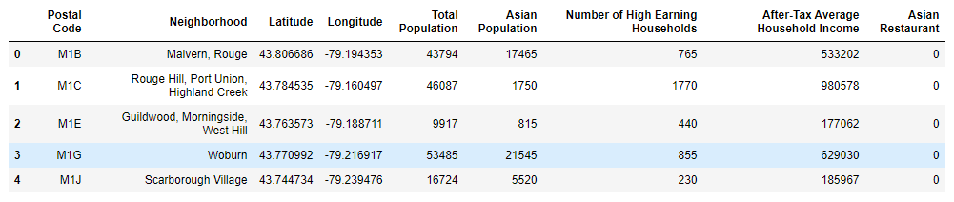
Data Collection
I used Toronto’s Neighborhood profile from Toronto’s Open Data Portal and Foursquare to build the following data set:

Slide 18
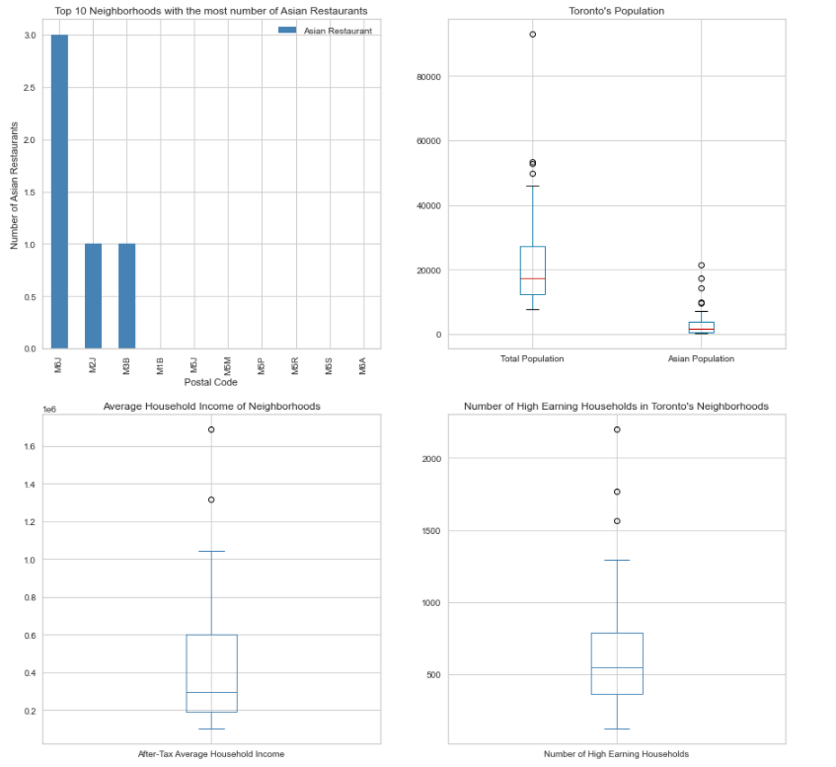
Exploratory Analysis
I performed some preliminary analysis on this data set as shown here:

Slide 19
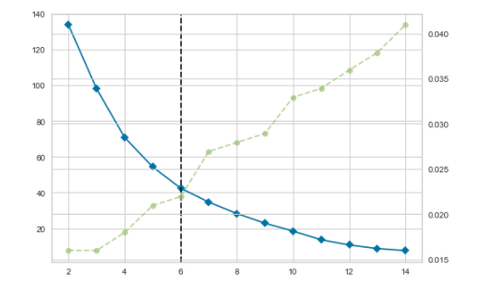
Clustering
This time I clustered neighborhoods on basis of the aforementioned features using K-Means clustering. For choosing the optimal k, I once again relied on elbow method (as it is quite reliable). You can see its graph below:

Slide 20
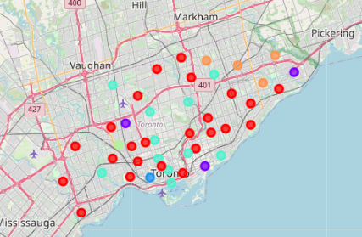
Here we can see that the best k is 6. So, I clustered neighborhoods into 6 groups and did show them on map as shown below:

Slide 21
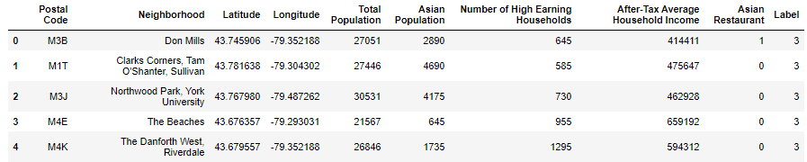
Conclusion
From all the clusters, cluster 3 was the closest to our ideal neighborhoods because it has following features:
1. Medium number of high earning households.
2. Medium average household income.
3. High percentage of Asian population.
4. Low to medium competition (compared to all other neighborhoods)
Here is the snapshot of cluster 3:

Slide 22
Future Directions
This project was a specific example, but this approach can be used for any other similar problem too.
For instance, if you want to explore some other city, if you want to find the most suitable neighborhood for you to live in, in some other city or, if you want to find the best location to open a specific business, you can use this approach.
For this specific example results can be improved if we have more insight about the Asian population in each neighborhood, for instance, the number of high earning Asian households and the average income of Asian households can improve results significantly.

